Slide 1
LF 101 – Part II lecture 1/14
Tuesday 23rd Feb 2016
Laws of Inheritance
(Genetics)

Slide 2
Available slots for LIF 101 lectures till Mid Sem Exam
Lecture # 1 :23 Feb
Lecture # 2: 26 Feb
---------------
Lecture # 3 : 01 March
Lecture # 4: 04 March
Lecture # 5 : 08 March
Lecture # 6 : 11 March
Lecture # 7 : 15 March
Lecture # 8 : 18 March
Lecture # 9 : 29 March
-------------------------------------
Lecture # 10 : 01 April
Lecture # 11 : 05 April
Lecture # 12 : 08 April
Lecture # 13 : 12 April

Slide 3

The transmission of biological characteristics from parents to off spring is heredity
Brain
Genetics is the study of heredity
Organism
Heart
cell
tissue
organs
Heredity
Genetics thus deals with:
what (chemically) is being transmitted,
how it is being transmitted and, finally,
how transmitted information finds its final appearance in the body
Molecules
Population
The scales of studies in Biology

Slide 4
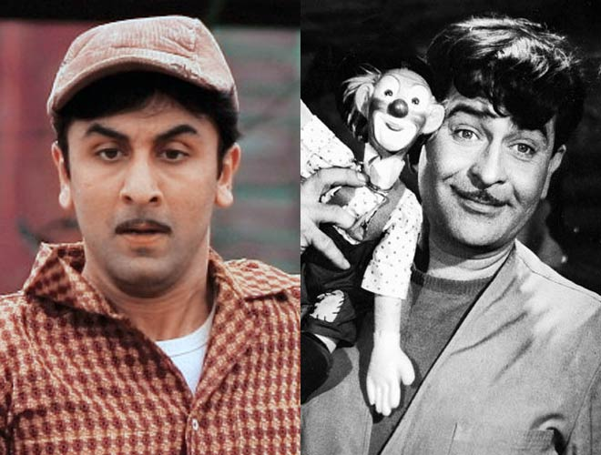
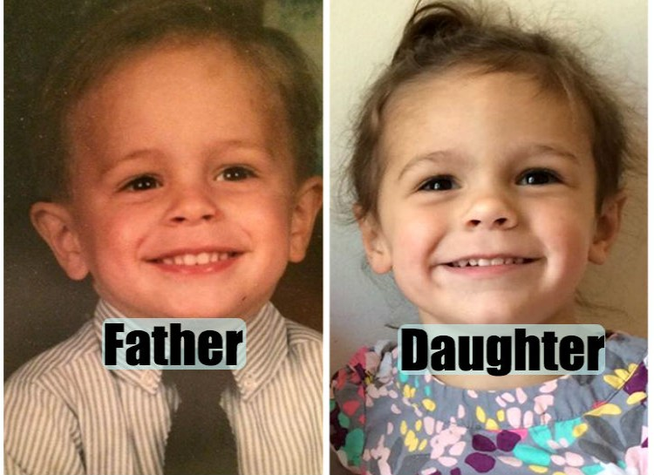
Resemblance between different generations within a family

Slide 5
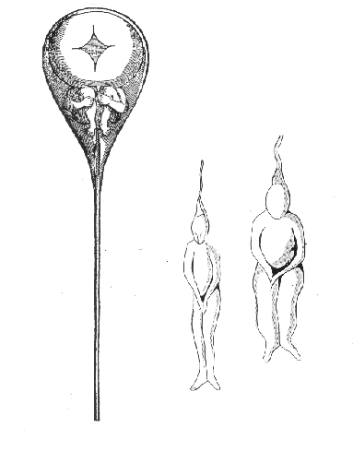
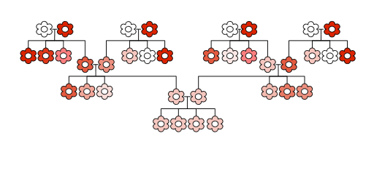
Ideas about heredity/inheritance
Preformation
N. Hartsoecker in 1695
Blending inheritance
19th Century

Slide 6
First scientific theory explaining heredity – Mendel’s laws

Slide 7
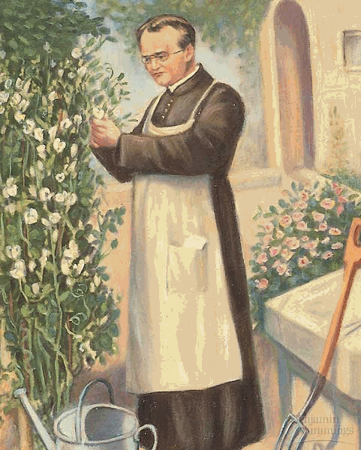
Gregor Johann Mendel (1822 – 1884)
Priest in Augustinian Monastery in Brno, Czechoslovakia
His work with peas laid the foundation for genetics. He was a University educated priest He studied math and science. He returned to the monastery and taught high school. He took care of the monastery’s garden.
He was curious why some plants were like their parents & others were not. He cross pollinated the pea plants by brushing pollen from the stamens of one plant to the pistil of another.
Peas normally self pollinate so he had to take the stamens that make pollen off the second plant.

Slide 8
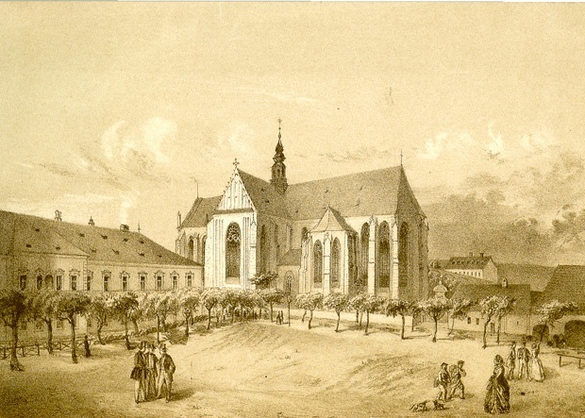
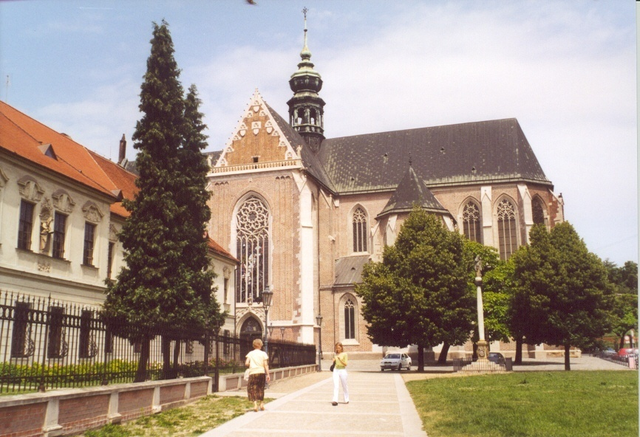
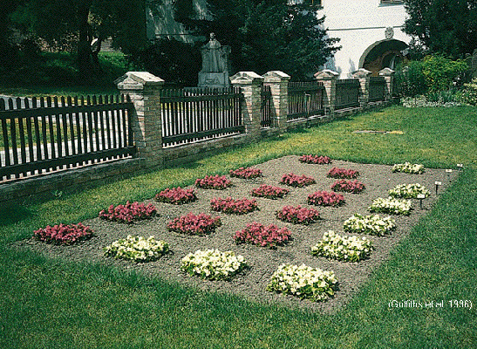
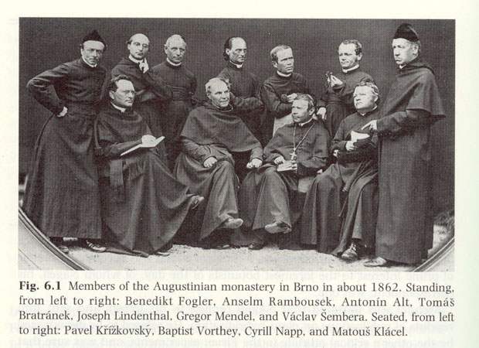
The Augustinian Abbey of St Thomas, Brno
In the early 1800s

Slide 9
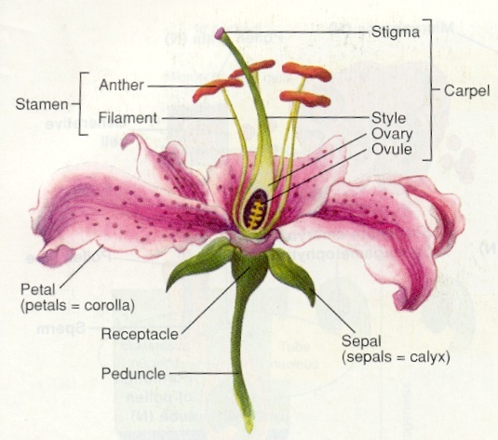
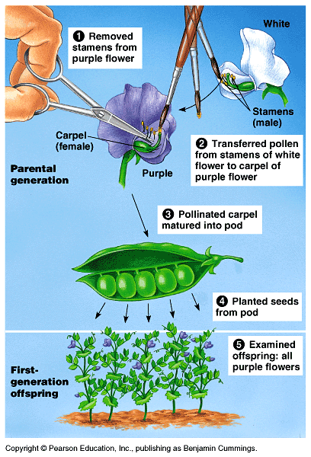
Mendel’s experiment
Note that there are specialized organs for reproduction
Flower:
Plant organ for sexual reproduction, that produces gametes (sex cells) and are necessary for fertilization to occur

Slide 10
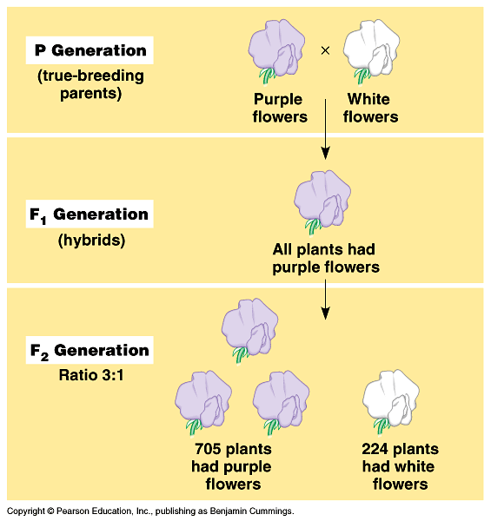
Mendel’s work represent one of the earliest example of experimental biology
What is true breeding?
Does this mean blending of inheritance?
Step 1 :
Carry out an experiment
&
examine the results
Does this refute/discard blending of inheritance?
What are P, F1 and F2

Slide 11
Step 2 : Make assumptions based on the observations
Heritable features are characters (coloration) and their variations are traits (purple or white).
Traits are determined by factors. ‘P’ for purple, ‘p’ for white Let’s assume traits are always in pairs: PP, Pp or pp
When two factors are present in the same individual one is seen physically – this is thus dominant (purple) while the other one (white) is recessive
Characteristics “seen” in an individual constitutes its phenotype (appearance). Characteristic “present” in an individual constitutes its genotype.
Note the terminologies introduced : character, trait, factors, dominant, recessive, phenotype, genotype.
Can you define these terms now?
Let’s now see if these assumptions help explain the results

Slide 12
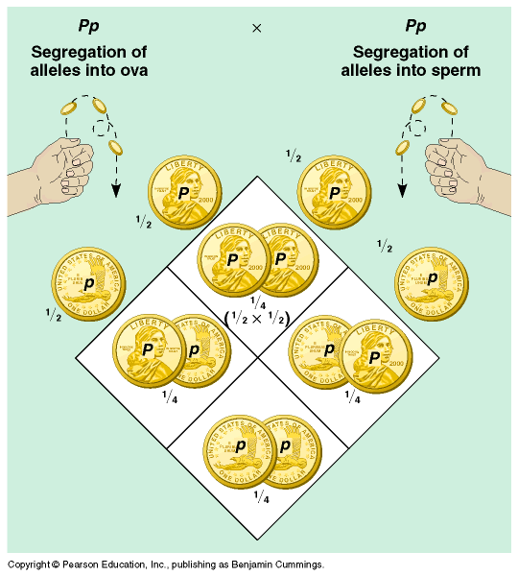
Step 3: Explain the results based on the observations &
assumptions made
Explanation based on laws of probability: chances of two independent event happening together is a multiple of their individual probability

Slide 13
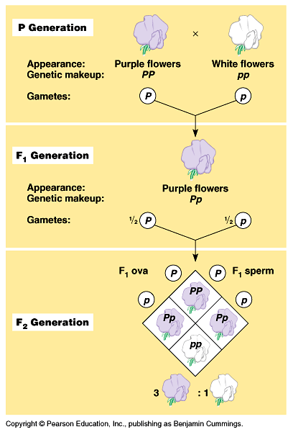
Interpret results
Interpretations are based on the assumptions made : factors represent traits, there are two factors for each trait in each plant – one maternally derived and the other paternally derived
Starting with PP and pp plants in the second generation (F2) we will end up with 3: 1 phenotypic ratio when the factors (P, p) segregate from each other during gamete formation
Note this term segregation:
Questions:
What segregates?
When ?
What is the evidence of their segregation?

Slide 14
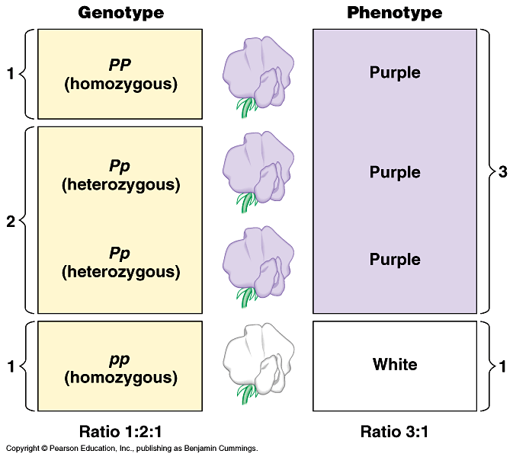
Genotypic and phenotypic ratios in F2 generations

Slide 15
What is the bare essential of Mendelian law/s of Inheritance?
Law of segregation
1. Allele (factor) pairs segregate (separate) during gamete formation, and randomly unite at fertilization .

Slide 16
A law can always be validated further
Test cross
Purple X White
Pp pp
Third Step :
Validate the idea further
??

Slide 17
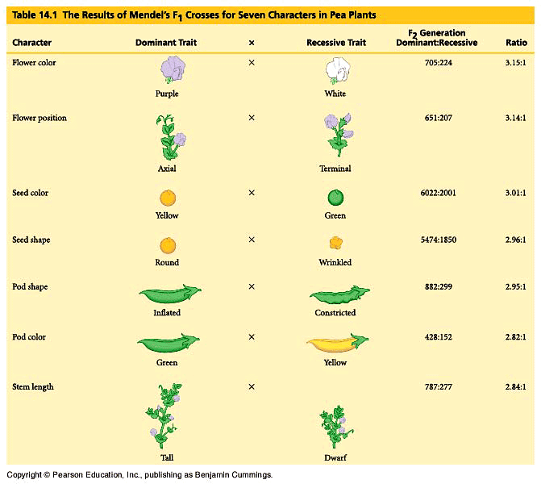
A law valid for all genes

Slide 18
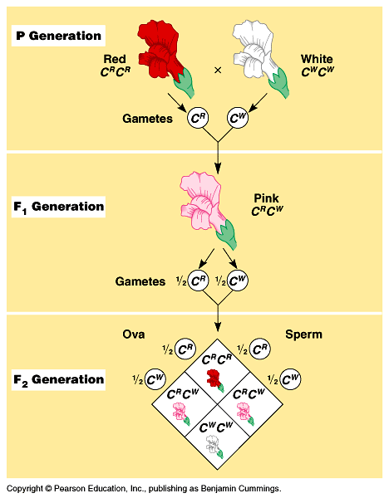
Note the flower colors of the parental generation, and then the F1 and F2 generations
Will this represent a deviation from Mendelian laws of inheritance??

Slide 19
Genetic vocabulary
Alleles: the factors representing a trait. Since we now call these factors as
genes, alleles essentially mean different version of the same gene
Carrier: An individual which is heterozygous, meaning a given pair of allele
are not identical. A carrier often carries a defective version of the
gene along with its normal version
Define the following:
Homozygous: ??
Law of segregation: ??
Phenotype: ??
Trait : ???
Dominant: ???
Connect two terms
Dominant and phenotype
Connect three terms
Dominant , phenotype and allele
Construct a full sentence using all the above terms shown in genetic vocabulary

Slide 20
Elementary test on Mendelian law
Q.1 How many different types of gametes are made by a parent of genotype Bb?
Q.2 Is the following statement true of false? If allele A is dominant to allele a, genotypes AA and Aa exhibit the same phenotype.
Q.3 From the cross Bb x Bb, where B is dominant over b, how many different phenotypes are produced among the offspring and in what proportions are they expected?
Q.4 From the cross Bb x Bb, where b is dominant to b, how many different genotypes are produced among the offspring and in what proportions are they expected?
Q.5 The dominant allele A causes seeds of maize to be colored, whereas the recessive allele a causes seeds to be colorless. From the cross Aa x Aa, what fraction of the seeds are colorless?

Slide 21
Solve problem: Application of Mendelian laws in understanding human inheritance & disease
Background Information
Beta-thalassemia is a form recessive genetic disorder that reduces the production of hemoglobin. In acute cases it is lethal. www.ygyh.org/thal/inherited (your genes your health)
Observation
Baby with Beta-thalassemia is born to a couple who were otherwise normal
Question
How will you explain this observation?
Unpack the problem first
beta-thalassemia is a recessive genetic disorder while the parents are normal: this means that both the parent are heterozygous and therefore carriers. T/t
Progeny of (T/t X T/t) would thus be: (T/T, T/t and t/t)
Since beta-thalassemia is recessive genetic disorder the unfortunate baby was genotypically t/t

Slide 22
Food for thought
Can the birth of the unfortunate thalassemic baby be avoided?
Can the carrier individuals be detected?

Slide 23
Can you now reject older ideas about heredity?
Preformation
N. Hartsoecker in 1695
Blending inheritance
19th Century

Slide 24
Next class
Will the law of segregation hold good when we consider many traits together?
Where do these Mendelian factors (alleles) reside?
How do they segregate?

